Slide 1
THIS VIDEO IS THE DEMONSTRATION OF THE
NAAN MUDHALVAN PROJECT

Slide 2
KALAIGNAR KARUNANITHI GOVERNMENT ARTS COLLEGE FOR WOMEN(A)
PUDUKKOTTAI
TEAM LEADER
A . SRI JANANI
TEAM MEMBER
S . SNEKA
C . SNEKA
S . SNEKA
R . SIVASANKARI

Slide 3
UNLOCKING INSIGHTS INTO
THE GLOBAL AIR TRANSPORTATION NETWORK
WITH TABLEAU

Slide 4
Project Template
1 INTRODUCTION
1.1Overview
This Global Air Transportation Network dataset is a comprehensive collection of information on airports,
airlines and their routes. It contains information such as names, cities, countries, codes (IATA and ICAO) longitudes, latitudes and altitudes of airports across the world with detailed time zone and daylight saving time data.Additionally, this includes information about airlines including their IDs, name aliases, IATA and ICAO codes,
callsigns country of origin and active/inactive status. Similarly, it also covers route details such as airline sources
to destination airports along with essential details like codeshare stakeholder if any stops required during this
journey along with the type of aircraft being used for that particular journey. This dataset has been compiled
through meticulous labor by researchers all over the world to give you a comprehensive detail into air transportation networks from around the globe. Boeing 747. Air transport network or air transportation network(AYN)is an example of transport network and spatial networks. The nodes of the network are the airports and the links represent direct flight routes between two airports. The world wide air transportation network is a critical infrastructure with high impact on mobility, trade and economy. However, air transport made its progress only after India attained Independence. In 1932, D. Tata won a contract to transport mail and went on to found Air India.Until 1990, international aviation in India Delhi, Bombay, Madras, and Calcutta. On February 10, 1929, Tata received India’s first pilot license.

Slide 5
1.2 Purpose Air travel is a form of travel in vehicles such as airplanes, jet aircraft, helicopters, hot air balloons, blimps, gliders, hang gliders, parachutes, or anything else that can sustain flight. Use of air travel has greatly increased in recent decades - worldwide it doubled between the mid-1980s and the year 2000. The worldwide air transportation network is a critical infrastructure with high impact on mobility, trade and economy. Another example are the air transport system of a country or a country’s own air transport company. It has no physical barriers as in the case of other mode of transport. Political boundaries are also immaterial although it has to observe the requirements of the International Law. The supreme advantage of air transport lies in its quickness. It is the fastest mode of transport. Air transport was nationalized in 1953. Alliance Air, Indian airlines, private scheduled airlines, and non-scheduled operators provide domestic air services.

Slide 6
2 PROBLEM DEFINITION & DESIGN THINKING 2.1 Empathy Map The Global transportation network : l The worldwide air transportation network is a small world network in which the number of nonstop connections from a given city. l The number of shortest paths going through given city have distributions that are scale-free. Air transportation: l A transportation means that passengers and freight are transported by aircraft such planes and helicopters. l Aviation includes the activities surrounding mechanical flight and the aircraft industry. Properties of air transport networks: l The air transportation network is complex network which has the properties of small- world networks and scale-free networks. The degree distribution of the nodes displays a heavy-tailed distribution.

Slide 7
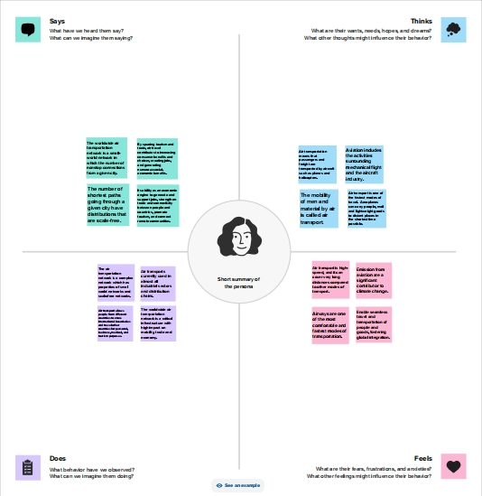
Types of air transportation: Helicopter, Airplane, Plane, Hot air balloon, Airship or Zeppelin, Paragliding, Paramotor, Cableway.

Slide 8
2.1 Ideation & Brainstorming Map Transportation management system : l Transportation management systems improve supply chain effeicience by automating and optimizing shipping processes. l It results in cost savings,increased visibility and control,and improved delivery times. Logistic and transportation : l Transportation focuses on the movement of goods from one place to another,While logistics is a broad term and includes freight management. l Logistics deals with the integration of storage,handling,sorting,packing,and transportation of goods.

Slide 9
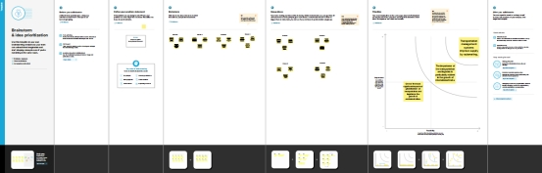
Difference between logistics and transportation : l Logistics and transportation deals with getting products and services from one location to another. l A good logistics network optimization needs to integrate analysis,feedback,and measurement .

Slide 10
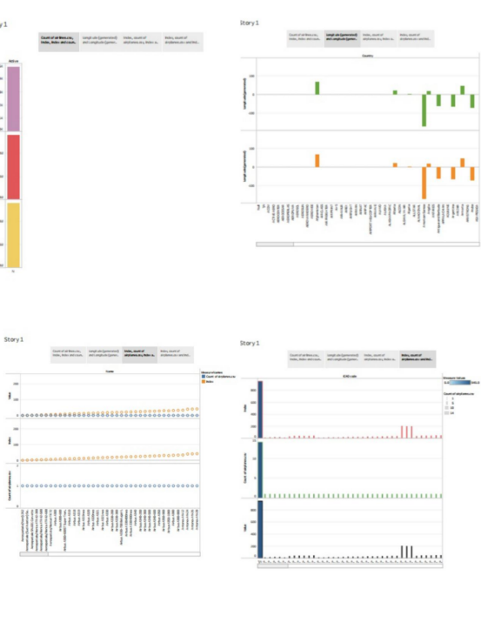
3 RESULT

Slide 11
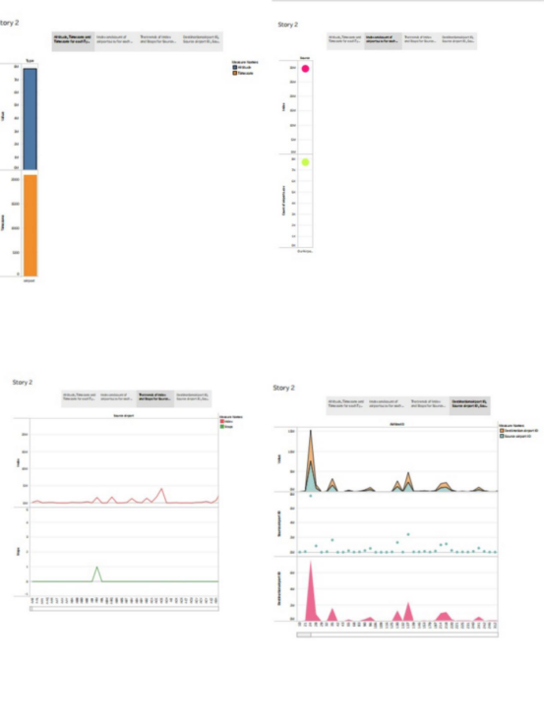
The worldwide air transportation network is a scale-free small-world network. In contrast to the prediction of scale-free network models, however, we find that the most connected cities are not necessarily the most central, resulting in anomalous values of the centrality.

Slide 12
ADVANTAGES AND DISADVANTAGES Advantages: l Fast delivery times. Undoubtedly, one of the most advantageous features offered by air transport is its speedy delivery times. l No Physical Limits. l Very reliable transportation. l Long Distances. l Higher Cost. l Less storage capacity. l Restrictions on goods. Disadvantages: l High Cost. This is significantly more costly for its services than land, rail, and water transportation. l Risky. l Limited capacity. l Uncertain and Unreliable. l Accident-prone. l Requires Skill. l Large Investment. Unfit for cheap and bulky goods.

Slide 13
APPLICATIONS Ø Air Transportation is the transportation of passengers and goods via aircrafts. The global air transportation market is expected to witness significant growth in the forecast period owing to the increasing air passenger traffic, growing number of airport expansion projects, and rising demand for air freight services. Ø Air transportation is one of the most important segments of the transportation sector. It is widely used for transportation of both passengers and goods due to its convenience, speed, and efficiency. Airlines are the major providers of air transportation services. They operate regular flights to various destinations across the globe. Ø The air transportation market is highly competitive and is characterized by the presence of a large number of players. The market is mainly driven by the increasing demand for air travel, airport expansion projects, and the rising demand for air freight services.

Slide 14
CONCLUSION In conclusion, air freight is a fast, flexible, and efficient shipping method that provides businesses with numerous benefits, including speed, flexibility, efficiency, and reduced risk of damage or loss. the Indian aviation industry has undergone significant developments and growth in recent years. The expansion of regional connectivity, emergence of low-cost carriers, increased investment in infrastructure, and adoption of technological advancements have all contributed to the growth of the industry. The transport system today plays a very vital role in the development of India. It can be ranked among the most important sectors of the Indian economy. It is the most significant event for transporting goods and services from one place to another.

Slide 15
FUTURE SCOPE u The demand for air travel in India is soaring due to a variety of trends taking place in the industry. India is expected to overtake China and the United States as the world's third-largest air passenger market in the next ten years, by 2030, according to the International Air Transport Association (IATA). u Experts in aviation can expect to make between INR 2 and INR 15 lakhs per year. Graduates who are engaged by a range of organisations have the best chances of success. One can quickly move from technical roles or management to hospitality services after completing training and a course. APPENDIX A Source Code https://github.com/NM2023TMID25668/Unlocking-Insights-into-the-Global-Air-Transportation-Network-with-Tableau_NM2023TMID25668/upload/main

Slide 16
THANK YOU

